Slide 1
Name of the presentation here
Sub title for authors names here

Slide 2
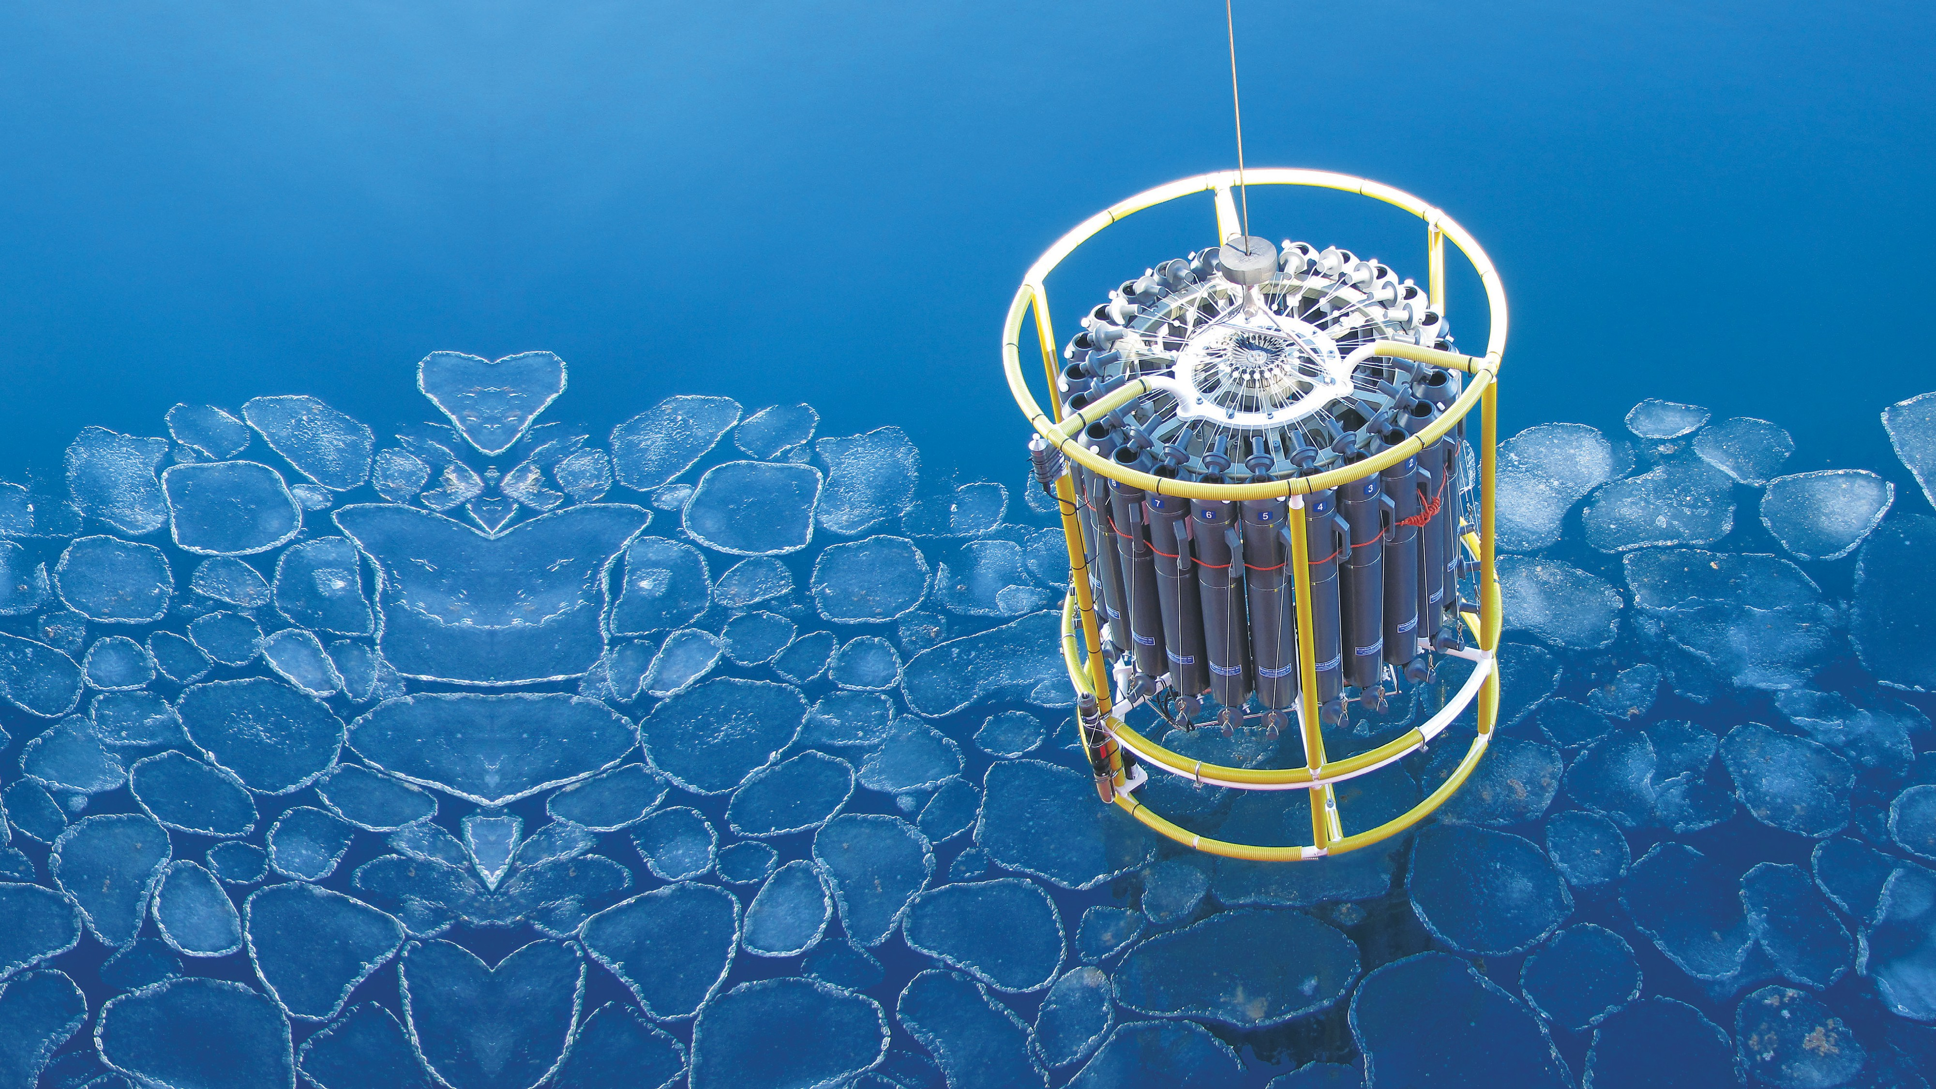
SOOS Mission
2 | SOUTHERN OCEAN OBSERVING SYSTEM
Our mission is to facilitate the sustained collection and delivery of essential observations of the Southern Ocean to all stakeholders, through the design, advocacy, and implementation of cost-effective observing and data delivery systems.

Slide 3
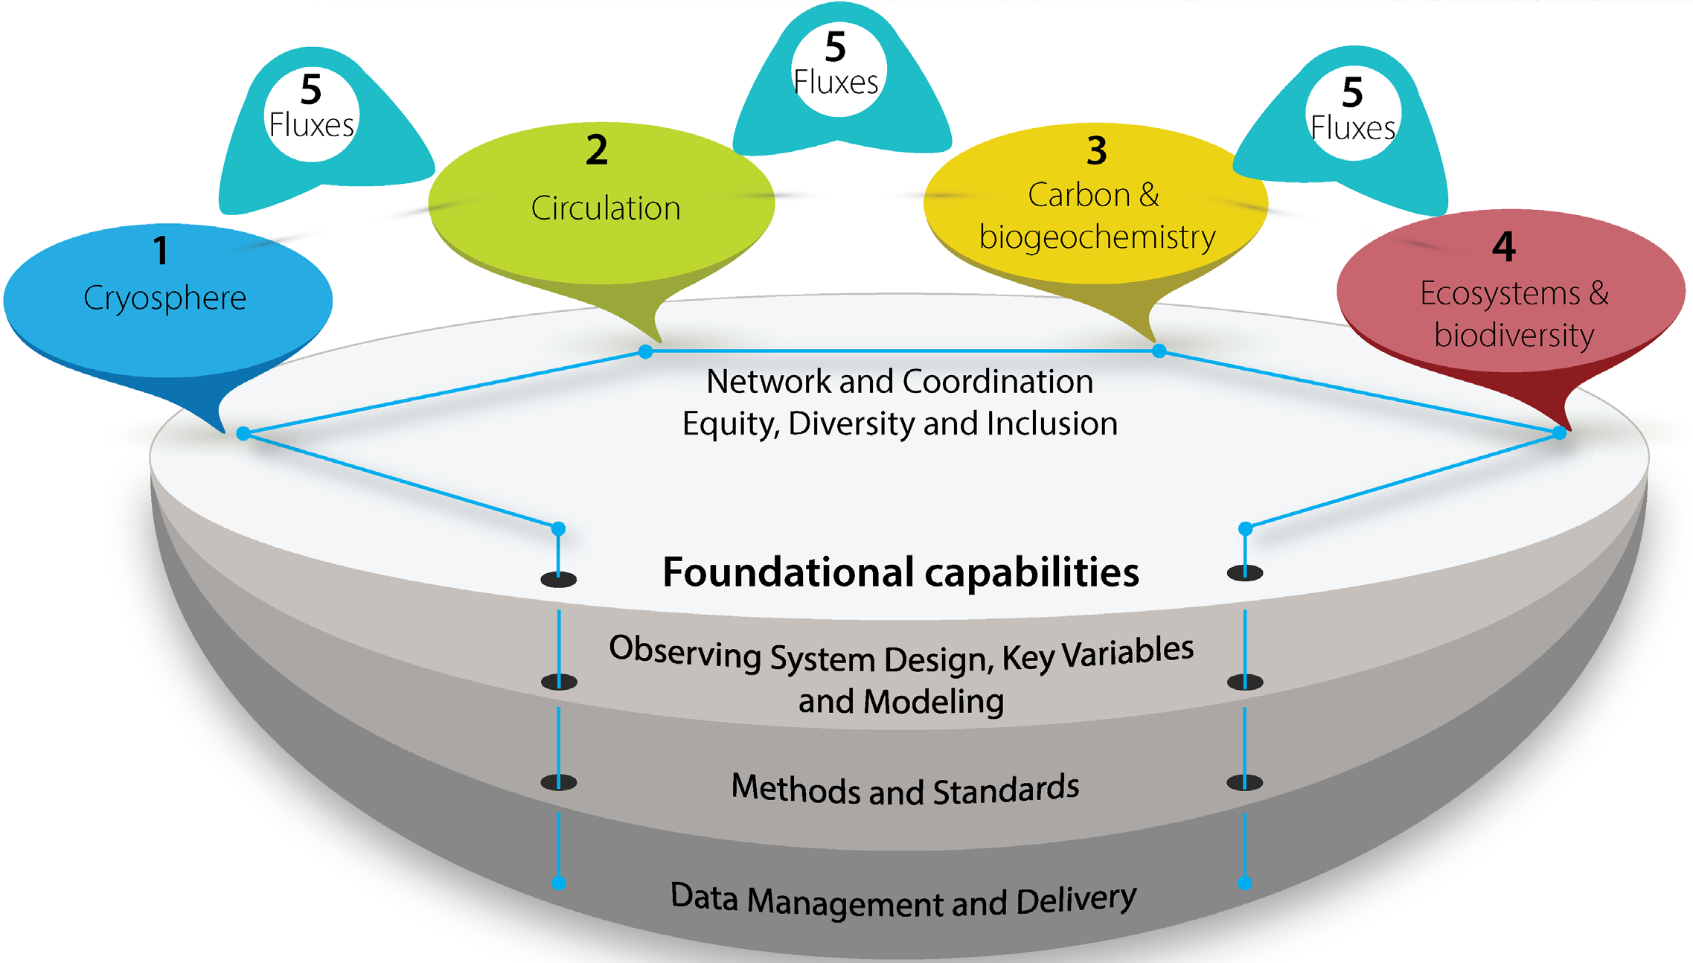
Science and Implementation Plan 2021-2025
3 | SOUTHERN OCEAN OBSERVING SYSTEM
Science Themes:
Cryosphere
Circulation
Carbon & Biogeochemistry
Ecosystems & Biodiversity
Southern Ocean – Sea Ice – Atmosphere Fluxes
Foundational Capabilities:
Observing System Design, Key Variables and Modelling
Methods and Standards
Data Management and Delivery

Slide 4
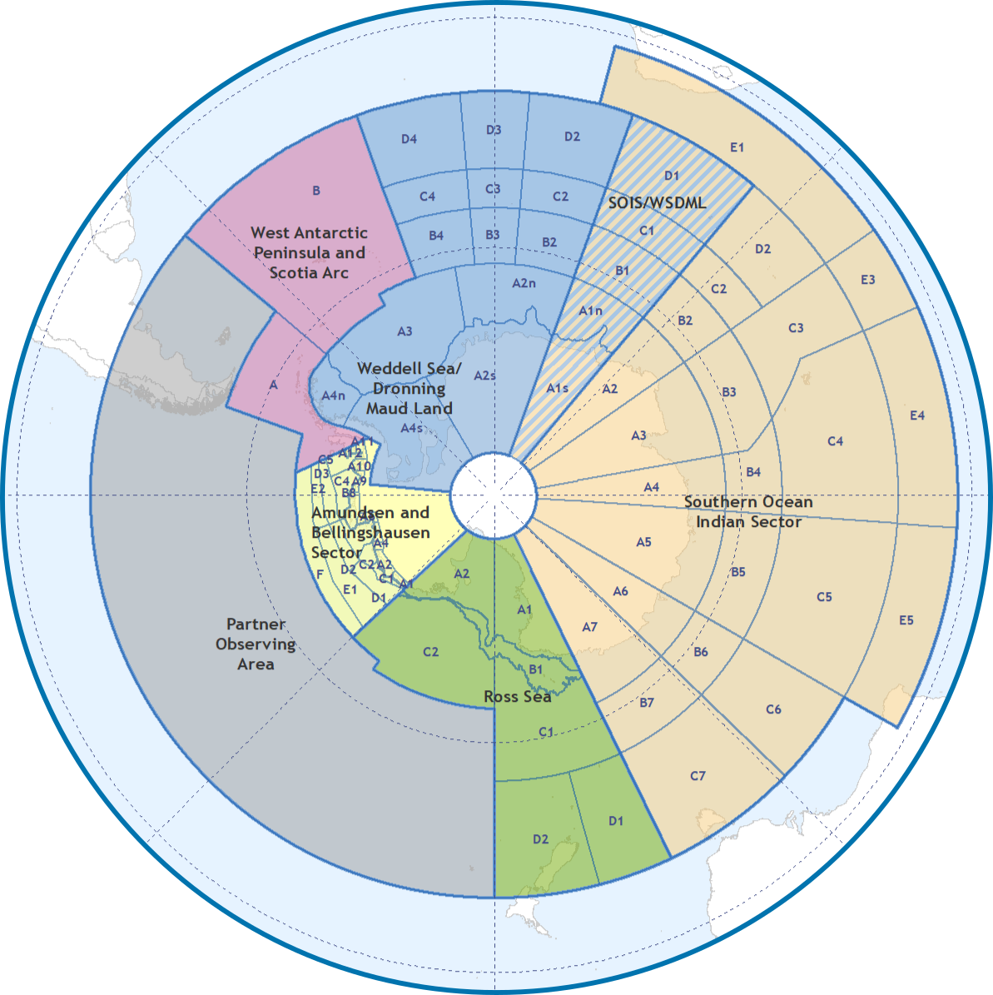
Knowledge delivery to address challenges
4 | SOUTHERN OCEAN OBSERVING SYSTEM
Data Management Sub-Committee
Regional Working Groups (RWGs):
Southern Ocean Indian Sector (SOIS)
Ross Sea
Weddell Sea and Dronning Maud Land (WSDML) West Antarctic Peninsula and Scotia Arc (WAPSA) Amundsen/Bellingshausen Sea (ABS)
Capability Working Groups (CWGs): Censusing Animal Populations from Space (CAPS) Southern Ocean Flux (SOFLUX)
Observing System Design (OSD)
Task Teams:
Ecosystem Essential Ocean Variables (eEOVs) Polar Technology
SOOS/GOA-ON Ocean Acidification Regional Hub
Equity, Diversity and Inclusion Group
Partnerships and Collaborations:
UN Ocean Decade Southern Ocean Decade Collaborative Centre
Marine Ecosystem Assessment of the Southern Ocean (MEASO)
Polar Data Discovery (POLDER) Southern Ocean Regional Panel (SORP) Antarctic biodiversity

Slide 5
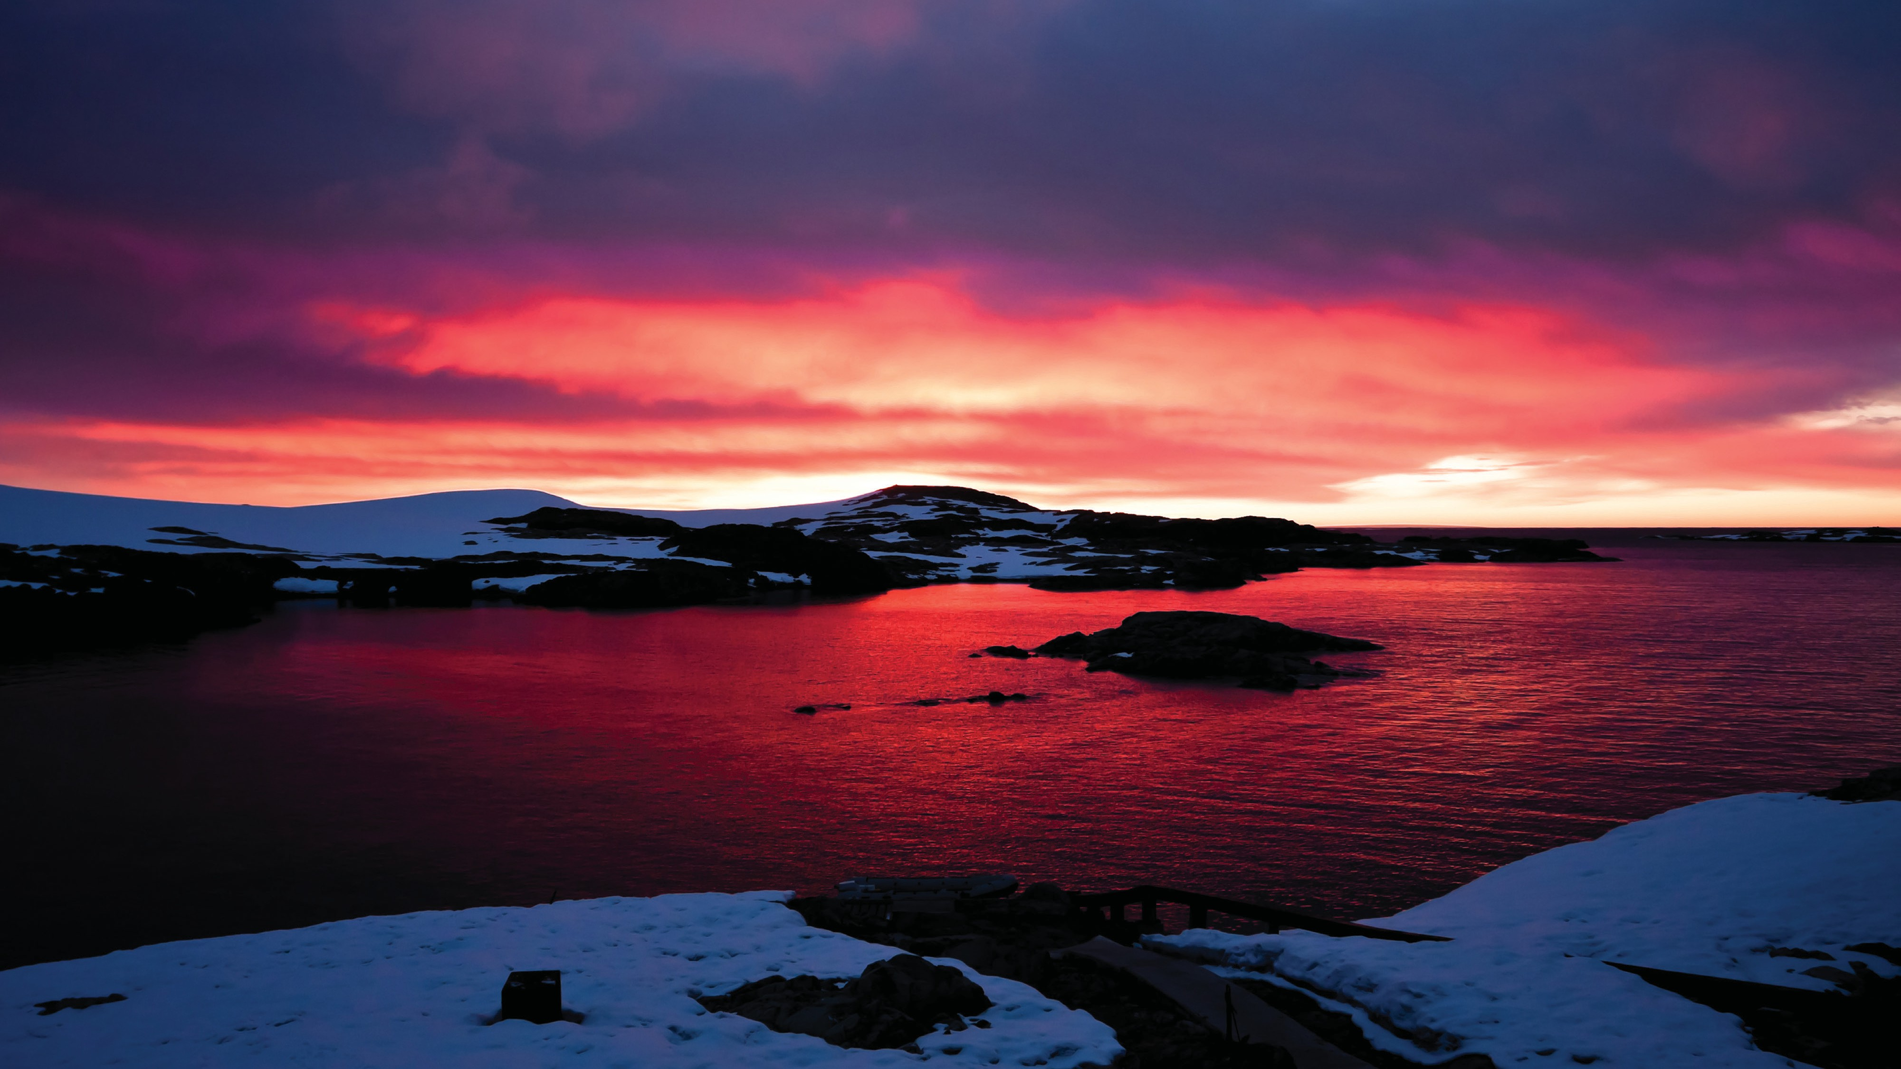
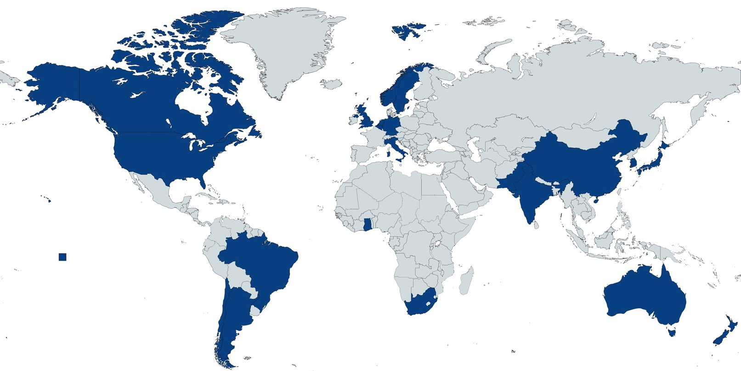
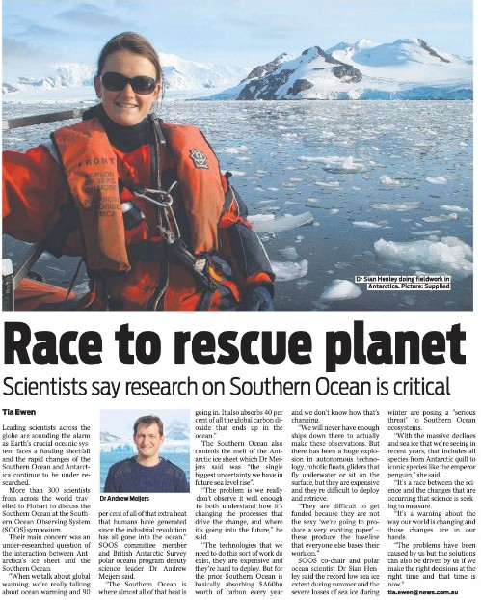
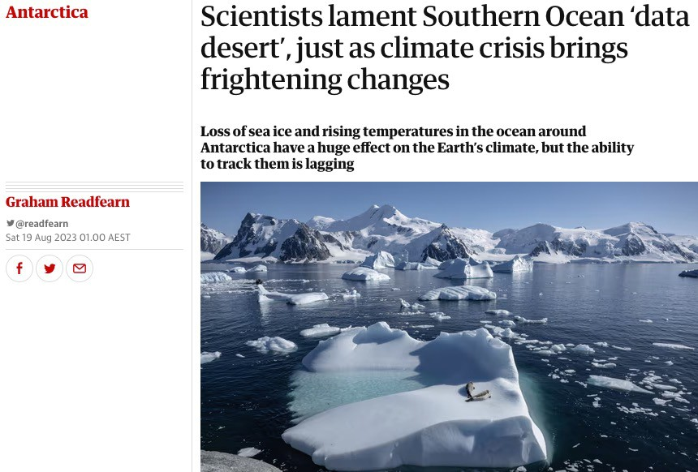
Hobart, Tasmania 10-20 August 2023 with side-meetings and workshops
5 | SOUTHERN OCEAN OBSERVING SYSTEM
SOOS Symposium 2023 “Southern Ocean in a Changing World”
300 attendees
from 25 countries
40+ media features - Australia, New Zealand, Europe, North and South America

Slide 6
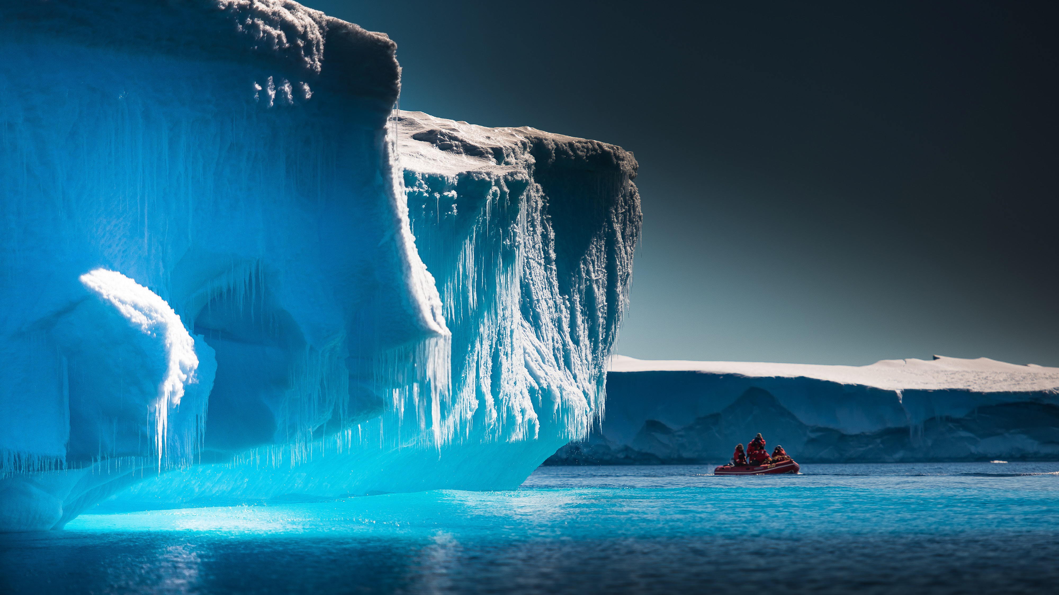
SOOS Symposium 2023 Community Statement
6 | SOUTHERN OCEAN OBSERVING SYSTEM
The Southern Ocean is a critical component of the global climate system. The Southern Ocean controls to a large extent the uptake of human generated heat and carbon
into the ocean. Yet, we are currently observing critical changes in the Southern Ocean that are seen in the record low levels of sea-ice extent, record high temperatures and dramatic shifts in penguin populations, among other striking changes. The chronic lack of observations for the Southern Ocean challenges our ability to detect and assess the consequences of change. As such, it is more pressing than ever to have a sustained and coordinated Southern Ocean observing system to provide an understanding of current conditions, inform predictions of future states, and support policies and regulations for the benefit of society.

Slide 7
@SOOSnews
southern-ocean-observing-system
soos.aq
info@soos.aq
@SOOSocean
@SOOS-Ocean
bit.ly/JoinSOOS
@SOOSocean.bsky.social
Institute for Marine and Antarctic Studies Waterfront Building, University of Tasmania, Private Bag 110 Hobart, TAS Australia, 7004
Phone +61 3 6226 6011
Email info@soos.aq

